Slide 1
The HTML DOM
Module 15

Slide 2
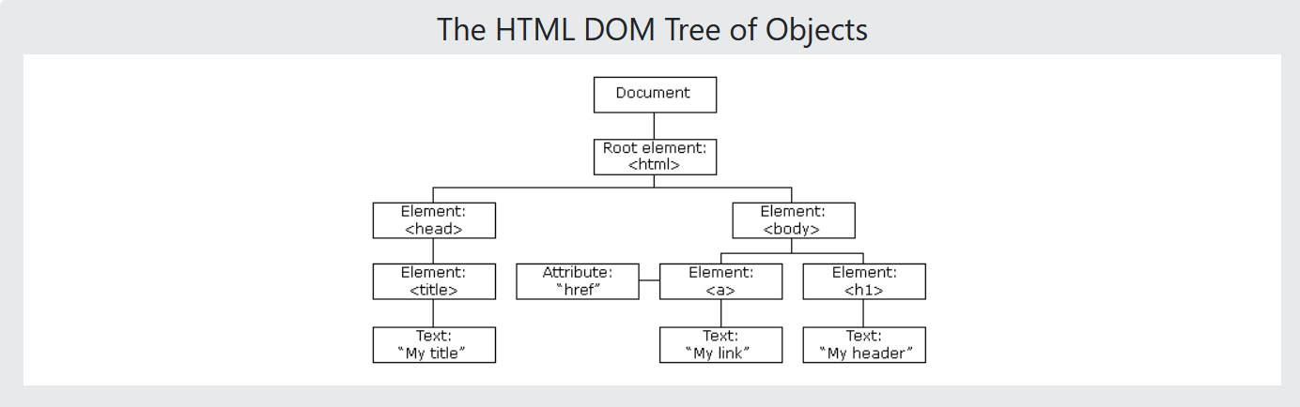
The Document Object Model (DOM)
When the page loads, the browser creates a Document Object Model of the page.
The HTML DOM is constructed as a tree (a data structure) of Objects

Slide 3
The Document Object Model (DOM)
Using the Document Object Model, JavaScript is empowered to create dynamic webpages:
Possibilities
Changing all HTML Elements in a page
Changing all HTML Attributes in a page
Changing all CSS styles in a page
Removing existing elements
Adding new elements
Reacting to events that occur in a page
Much, much more

Slide 4
What is the DOM?
The DOM is a W3C (World Wide Web Consortium) standard for accessing documents
"The W3C Document Object Model (DOM) is a platform and language-neutral interface that allows programs and scripts to dynamically access and update the content, structure, and style of a document."

Slide 5
What is the DOM?
The W3C DOM is separated into 3 separate parts:
The Core DOM – a standard model for accessing all document types
XML DOM – a standard model for accessing XML docs
HTML DOM – a standard model for accessing HTML docs
We’re interested in the HTML DOM

Slide 6
What is the HTML DOM?
HTML DOM: a standard object model and programming interface for HTML
It defines:
HTML Elements as Objects
Properties of all HTML elements
Methods to access all HTML elements
Events all HTML Elements

Slide 7
DOM Methods

Slide 8
The DOM Programming Interface
The HTML DOM can be accessed with JavaScript, but also other languages like Python, Ruby, PHP, and Java.
DOM Properties are values you can set and change, like the content of a <p> element
DOM Methods are actions you can take on DOM objects, like deleting or adding an entire <p> element

Slide 9

getElementById()
By far, the most common DOM method you’ll need is getElementById(“element-id-name”)
This method returns an Object representing the element an element with the given id (element-id-name).
That element will have the innerHTML property, which we can use to change whatever is inside of the element

Slide 10
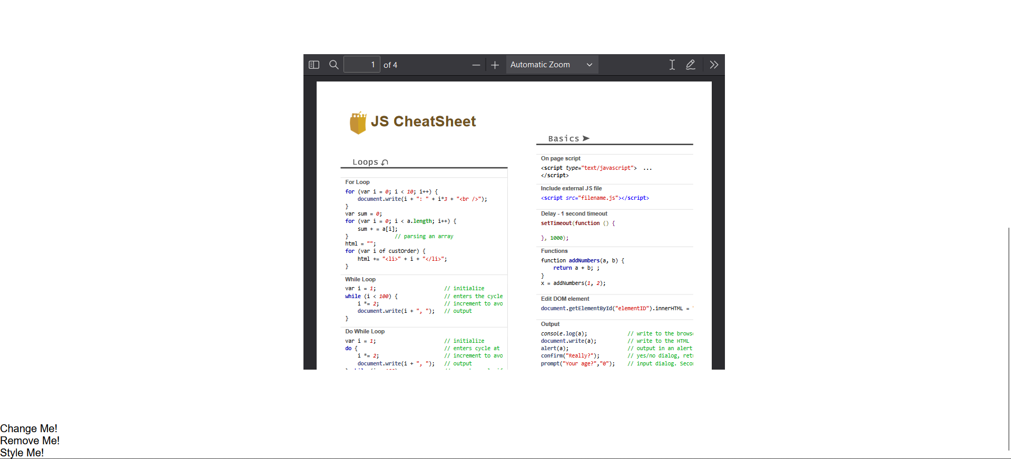
DOM Method Example

Slide 11
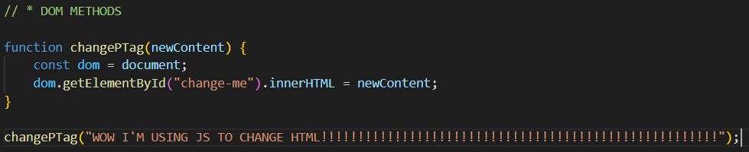
DOM Method Example

Slide 12
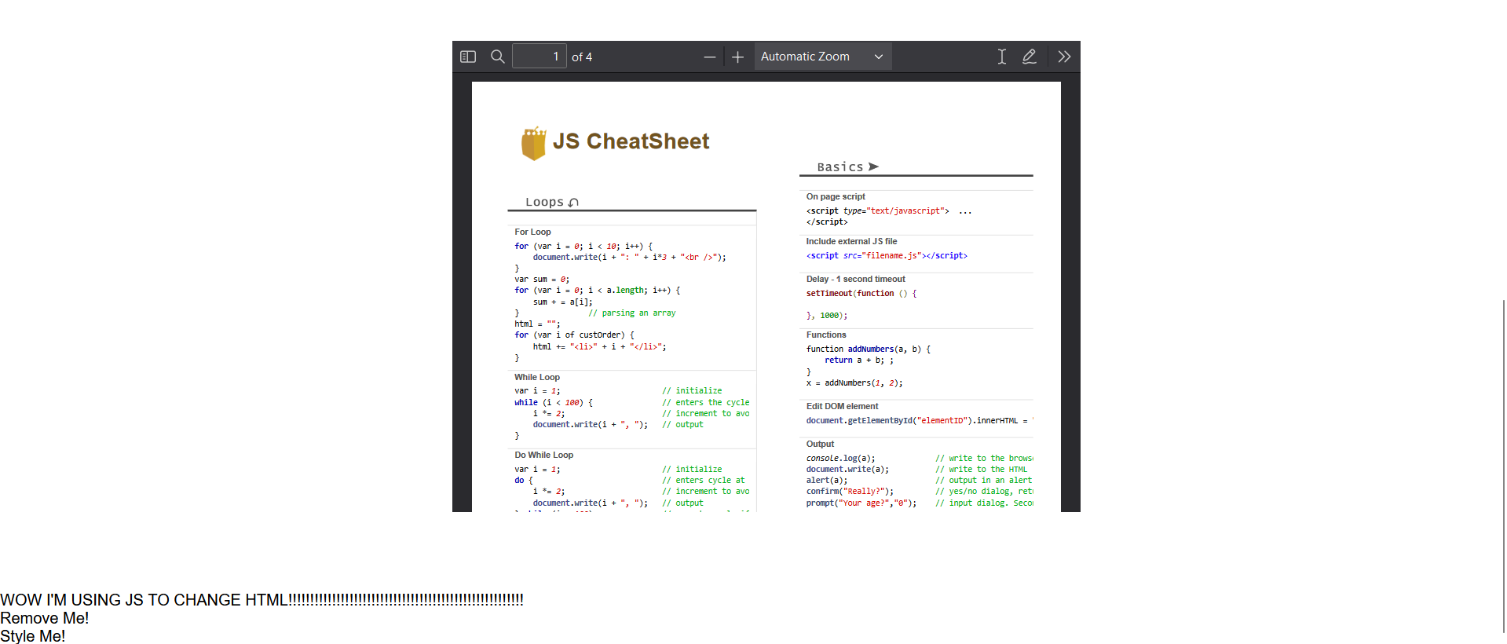
DOM Method Example

Slide 13
DOM Document

Slide 14

The HTML DOM Document Object
The Document object is an object representation of your web page
Any time you want to access an element, you always access the document object first

Slide 15
getElementById()
By far, the most common DOM method you’ll need is getElementById(“element-id-name”)
This method returns an Object representing the element an element with the given id (element-id-name).
That element will have the innerHTML property, which we can use to change whatever is inside of the element

Slide 16
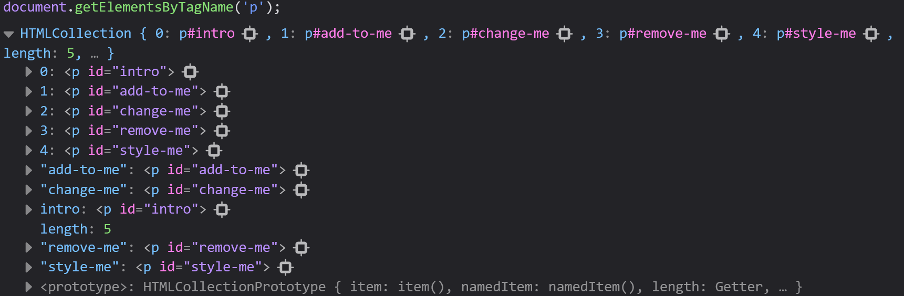
getElementsByTagName(name)
Selects all HTML elements of a certain name and returns an HTML Collection

Slide 17
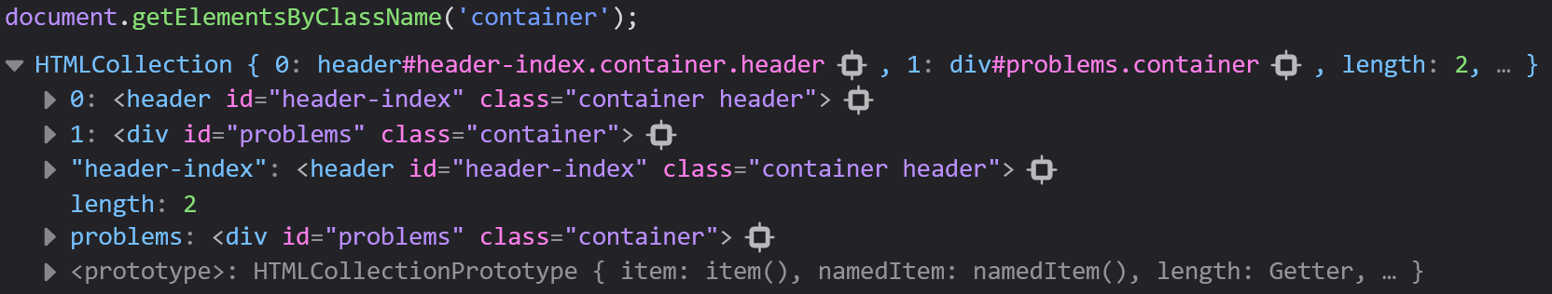
getElementsByClassName(name)
Selects all HTML elements of a certain class and returns an HTML Collection

Slide 18

The innerHTML Property
Changes the inner HTML of an element
Can write HTML code in addition to changing the text of an element

Slide 19


The style Property
Gives us access to all CSS properties
Allows us to change anything that we can set in CSS

Slide 20
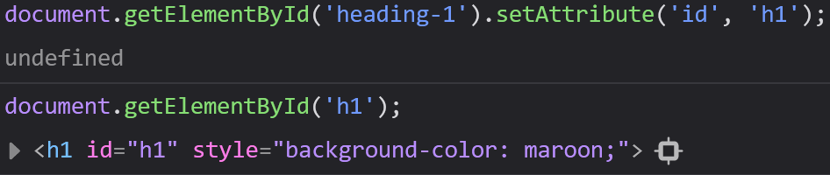
Changing HTML Element Attributes
You can also change HTML attributes by select an element and using the setAttribute(attribute, newValue)

Slide 21

Changing HTML Element Attributes
You can access any HTML element attribute using that attribute’s name
The attribute will appear as a property of the element you select

Slide 22
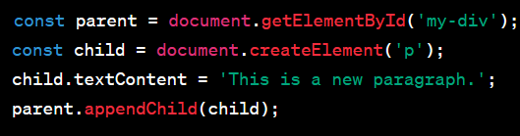
Adding Elements
document.createElement(element)
Creates an HTML element
document.appendChild(element)
Adds a child element
document.replaceChild(new, old)
Replaces an HTML element with a new element

Slide 23
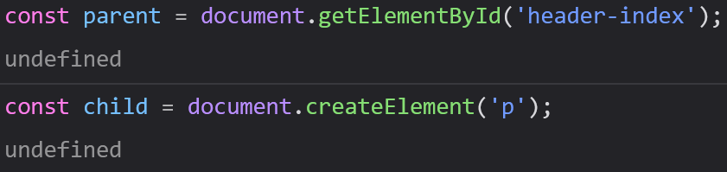
Create Elements
You can create entire new HTML elements using document.createElement(elementName)

Slide 24
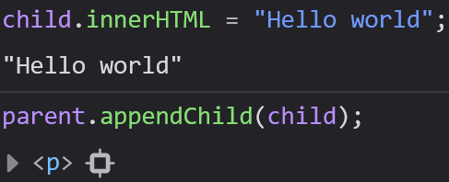
Adding New Elements to the Page
We can add children to other elements using document.appendChild(element)

Slide 25
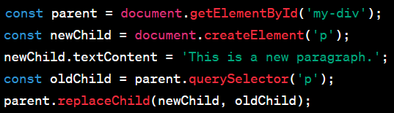
Deleting Elements
document.removeChild(element)
Removes an HTML element from a parent element

Slide 26
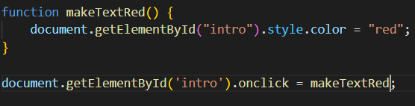
Adding Event Handlers
document.getElementById(id).onclick = function() { code }
Adds a new event handler to an onclick event

Slide 27
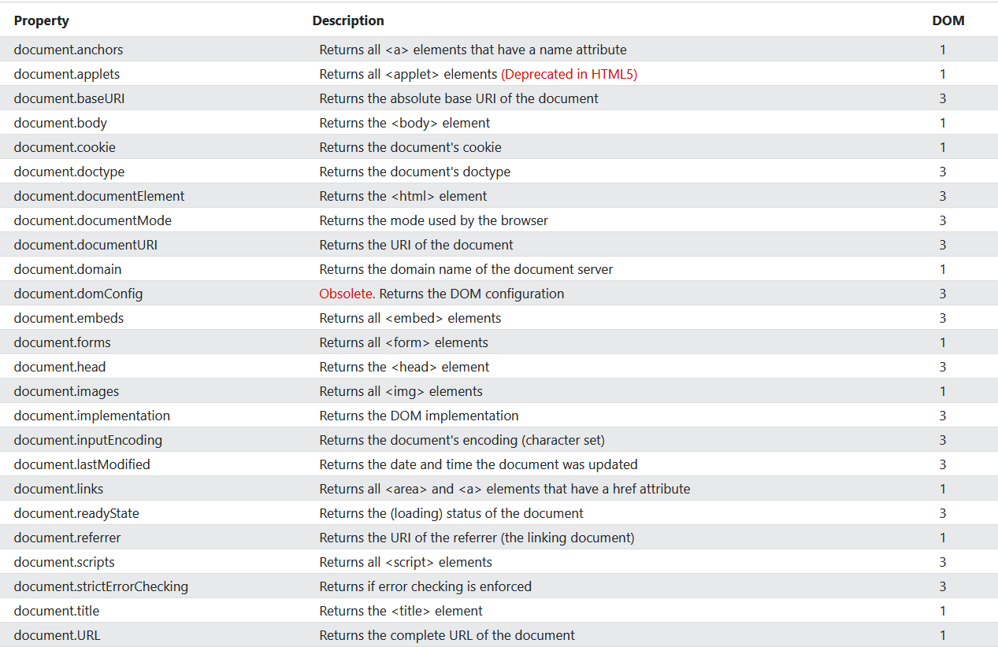
More DOM Objects

Slide 28
DOM Elements

Slide 29
Finding HTML Elements
To operate on an element using the DOM, you’ll have to find it first.
There are lots of ways to find an element:
Finding elements by id
Finding elements by tag name
Finding elements by class name
Finding elements by css selector
Finding elements by HTML object collection

Slide 30

Finding HTML Elements by ID
This is the easiest way to select an element
This will only select a single element
document.getElementById(‘intro’) will search for an return an Object of the element that you were looking for, or a null value if it does not exist

Slide 31

Finding HTML Elements by Tag Name
document.getElementsByTagName(name)
This will find all child elements, like <p> or <div> and return them in a collection
You can call this method on another element to search for tags within another element

Slide 32

Finding HTML Elements by Class Name
document.getElementsByClassName(name)
Returns all elements of a certain class name

Slide 33
Finding HTML Elements by CSS Selectors
document.querySelectorAll(‘p.intro’);
Finds all HTML elements that match a certain CSS Selector
Returns a list of all <p> elements with class=‘intro’

Slide 34
DOM HTML

Slide 35
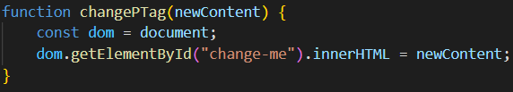
Changing the HTML Content
The easiest way to change the content of an HTML element is using the innerHTML property
Syntax: document.getElementById(id).innerHTML = new HTML

Slide 36
Changing the Value of an Attribute
document.getElementByid(id).attribute = new value
This is a great way to change the value of the image of a src

Slide 37
DOM CSS

Slide 38
Changing HTML Style
document.getElementById(id).style.property = new style
This will change any style of your choosing to a new style (like color, background, font-family, etc)

Slide 39
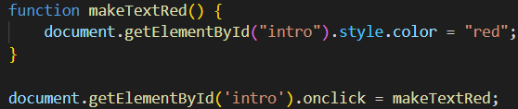
Using Events
The DOM allows you to execute code (usually functions) when an event occurs
Events are generated by the browser when “things happen” to HTML Elements, like being clicked on

